Slide 1
CSCI3420 Tutorial 6
Single Cycle CPU: A Case Study
Project Phase 2
Week 7
K.K. Tong

Slide 2
Overview
CPU can be abstracted as state machine
An execution that
Read contents from state element
Send values through combinational logic
Write contents to state element
State Element
#1
Combinational Logic
State Element
#2

Slide 3
Overview
A single clock CPU
State Element
Combinational Logic
Data
Register
PC
Register #
Address
Instruction
ALU
A
ddress
Register #
Instruction
Memory
Data
Memory
Register #
D
ata

Slide 4
Basic dataflow
Essential components: instruction fetch unit, branch unit, registers, ALUs, memory, control unit
Control unit
Branch unit
Instruction fetch unit
Registers
ALUs
Memory

Slide 5
Flow of execution
Read Inst
Decode Inst, pass to control
Control sends signals
Registers read
Use ALU/Jump
Memory read
Update PC
Write registers

Slide 6
Single-Cycle CPU - A Case Study
Only focus on a subset of MIPS
arithmetic / logic: add, sub, and, or
memory-referenced: lw, sw
branch: beq
A Case Study
It covers the main concept

Slide 7
Datapath components
Multiplexer (data selector)
Instruction fetch unit
Register file
ALU
Sign-extension unit (16 bit -> 32 bit)
Memory (instruction / data)

Slide 8
Multiplexer
0
0
1
Mux
Mux
1
2
sel
3
sel

Slide 9
Instruction fetch unit
Fetching instructions and increasing the program counter by 4
ADD
4
PC
Read
Address
Instruction
Instruction
Memory

Slide 10
Instruction fetch unit
Execute
0x4000 addi $s0, $zero, 5
0x4004 and $s0, $s0, $zero
0x4008 addi $s0, $s0, 1
0x4004
0x4000
ADD
4
PC
Read
Address
Instruction
PC update when the clock rise
addi $s0, $zero, 5
Instruction
Memory

Slide 11
Instruction fetch unit
Execute
0x4000 addi $s0, $zero, 5
0x4004 and $s0, $s0, $zero
0x4008 addi $s0, $s0, 1
0x4008
0x4004
ADD
4
PC
Read
Address
Instruction
PC update when the clock rise
and $s0, $s0, $zero
Instruction
Memory

Slide 12
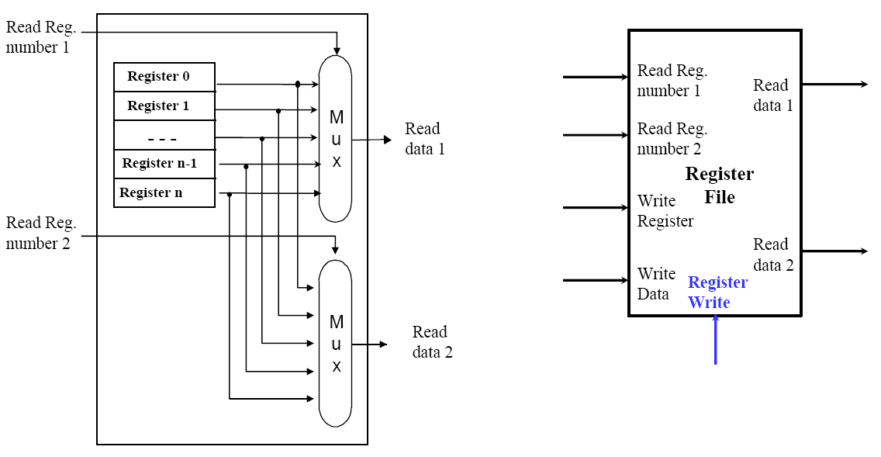
Register File (Read)

Slide 13
Register File (Write)

Slide 14
ALU
ALU Operation | Desired ALU action
000 | and
001 | or
010 | add
110 | sub
3
ALU Operation
Zero
ALU
ALU
result
OP | MIPS Instruction
add | lw, sw,…
sub | beq,…
Obtained from the specification of the ALU

Slide 15
Data memory & sign extension
MemWrite
Why need sign extend?
16
Sign
extend
32
Address
Read
data
32-bit ALU !
Data
Memory
Write
data
1 word = 4 bytes (in 32-bit Architecture)
MemRead
shift
left 2
Word address
Byte address
Address | Instruction
100 | add $t1, $t1, $s6
104 | sub $t1, $t1, $s6
108 | addi $s1, $s1, 1
beq $s1, $s2, 25 => if($s1 == $s2) go to PC+4+100

Slide 16
MIPS instruction type
0
R-type
I-type
J-type
op | rs | rt | rd | shamt | funct
add,sub,…
31:26 25:21 20:16 15:11 10:6 5:0
35 /43
op | rs | rt | immediate
lw,sw,beq,…
31:26 25:21 20:16 15:0
16
op | target address
j,…
31:26 25:0
Field | Description
o | Instruction opcode
s | First source register
t | Second source register
d | Destination register
a | Shift amount
f | Function
Read register 1&2: [25:21], [20:16]
Register destination: [15:11] (R-type) or [20:16] (I-type)
Base register for calculating address: [25:21]
Offset for beq/load/store: [15:0]

Slide 17
Simple datapath for this example
Given the below components, how to connect them to form a single cycle CPU?
MemWrite
ADD
RegWrite
3
ALU Operation
4
5
Read
register 1
Address
Read
data
Read
data 1
32
Zero
PC
Read
Address
5
Read
register 2
ALU
Data
Memory
Instruction
ALU
result
5
Write
register
Read
data 2
32
Write
data
Instruction
Memory
32
Write
data
Registers
MemRead
16
Sign
extend
32
shift
left 2
offset

Slide 18
Simple datapath for this example
PCSrc
Add
M
u
4
Add
ALU
result
x
RegWrite
Shift
left 2
3 ALU Operation
Read
register 1
MemWrite
R
e
a
PC
a
d
Read
data 1
MemToReg
d
d
r
e
s
s
Read
register 2
ALUSrc
Zero
I
n
s
t
r
u
c
t
i
o
[
n
M
U
x
ALU
3
1
–
0
]
Write
register
Read
data 2
ALU
result
Address
Read
data
Instruction
memory
M
M
Write
data
Registers
u
Data
Memory
u
x
x
Write
data
1
6
3
Sign
extend
2
MemRead
Register destination: [15:11] (R-type) or [20:16] (I-type)

Slide 19
Basic Datapath
R-type:
op | rs | rt | rd | shamt | funct
31:26 25:21 20:16 15:11 10:6 5:0
add $s1, $s2, $s3
PCSrc
PCSrc
0
Add
M
u
ALU
result
x
4
Add
1
$s2
RegWrite
Shift
left 2
Branch
Instruction [25-21]
Read
register 1
($s2)
MemWrite
R
e
a
PC
a
d
Read
data 1
d
d
r
e
s
s
Instruction [20-16]
Read
register 2
($s3)
ALUSrc
Zero
MemToReg
I
n
s
t
r
u
c
t
i
o
[
n
$s3
0
ALU
3
1
–
0
]
M
Write
register
Read
data 2
0
ALU
result
Address
Read
data
1
Instruction
memory
u
M
M
Instruction [15-11]
x
Write
data
Registers
u
Data
Memory
u
1
x
x
$s1
1
Write
data
0
RegDst
1
6
3
Instruction [15-0]
Sign
extend
2
ALU
control
MemRead
Instruction [5-0]
($s2)+($s3)
ALUOp[2-0]

Slide 20
Basic Datapath
I-type:
op | rs | rt | immediate
31:26 25:21 20:16 15:0
lw $s0, (100)$s1
PCSrc
0
Add
M
u
ALU
result
x
4
Add
1
$s1
RegWrite
Shift
left 2
Branch
Instruction [25-21]
Read
register 1
($s1)
MemWrite
R
e
a
PC
a
d
Read
data 1
d
d
r
e
s
s
Instruction [20-16]
Read
register 2
ALUSrc
Zero
MemToReg
I
n
s
t
r
u
c
t
i
o
[
n
$s0
0
ALU
3
1
–
0
]
M
Write
register
Read
data 2
0
ALU
result
Address
Read
data
1
Instruction
memory
u
M
M
Instruction [15-11]
x
Write
data
Registers
u
Data
Memory
u
1
x
x
1
Write
data
0
RegDst
1
100
6
3
Instruction [15-0]
Sign
extend
2
100
ALU
control
MemRead
Instruction [5-0]
Mem[($s1)+100]
ALUOp[2-0]

Slide 21
Basic Datapath
I-type:
op | rs | rt | immediate
31:26 25:21 20:16 15:0
beq $s0, $s1, 2500
PCSrc
0
Add
M
u
ALU
result
x
4
Add
1
$s0
RegWrite
Shift
left 2
Branch
Instruction [25-21]
Read
register 1
($s0)
MemWrite
R
e
a
PC
a
d
Read
data 1
d
d
r
e
s
s
Instruction [20-16]
Read
register 2
($s1)
ALUSrc
Zero
MemToReg
I
n
s
t
r
u
c
t
i
o
[
n
$s1
0
ALU
3
1
–
0
]
M
Write
register
Read
data 2
0
ALU
result
Address
Read
data
1
Instruction
memory
u
M
M
Instruction [15-11]
x
Write
data
Registers
u
Data
Memory
u
1
x
x
1
Write
data
0
RegDst
1
6
3
Instruction [15-0]
Sign
extend
2
ALU
control
MemRead
Instruction [5-0]
ALUOp[2-0]

Slide 22
Control Unit
Control Signal
PCSrc
0
Add
M
u
ALU
result
x
4
Add
1
RegWrite
Shift
left 2
Branch
Instruction [25-21]
Read
register 1
MemWrite
R
e
a
PC
a
d
Read
data 1
d
d
r
e
s
s
Instruction [20-16]
Read
register 2
ALUSrc
Zero
MemToReg
I
n
s
t
r
u
c
t
i
o
[
n
0
ALU
3
1
–
0
]
M
Write
register
Read
data 2
0
ALU
result
Address
Read
data
1
Instruction
memory
u
M
M
Instruction [15-11]
x
Write
data
Registers
u
Data
Memory
u
1
x
x
1
Write
data
0
RegDst
1
6
3
Instruction [15-0]
Sign
extend
2
ALU
control
MemRead
Instruction [5-0]
ALUOp[2-0]

Slide 23
Control Unit
Main
Control
RegDst
Branch
MemRead
MemtoReg
ALUOp
MemWrite
ALUSrc
RegWrite
R
e
a
PC
a
d
Instruction [31-26]
d
d
r
e
s
s
I
n
s
t
r
u
c
t
i
o
[
n
3
1
–
0
]
Instruction
memory
ALU
Control
Instruction [5-0]
ALU

Slide 24
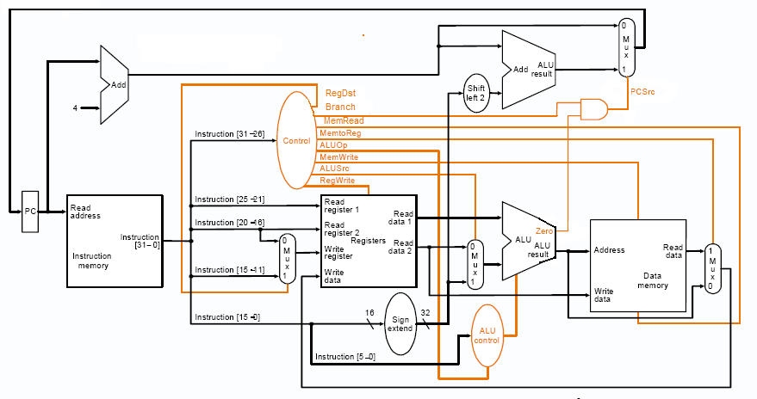
Complete Datapath with Control Unit

Slide 25
Control unit
Instruction | RegDst | ALUSrc | MemtoReg | RegWrite | MemRead | MemWrite | Branch | ALUOp1 | ALUOp0
R-format | 1 | 0 | 0 | 1 | 0 | 0 | 0 | 1 | 0
lw | 0 | 1 | 1 | 1 | 1 | 0 | 0 | 0 | 0
sw | X | 1 | X | 0 | 0 | 1 | 0 | 0 | 0
beq | X | 0 | X | 0 | 0 | 0 | 1 | 0 | 1

Slide 26
Signal | Effect when setting as 0 | Effect when setting as 1
RegDst | The register destination number for the write register comes from the rt field (bits 20:16) | The register destination number for the write register comes from the rd field (bits 15:11)
RegWrite | None | The register on the Write register input is written with the value on the write data input.
ALUSrc | The second ALU operand comes from the second register file output (Read Data 2) | The second ALU operand comes from the sign-extended, lower 16 bits of instruction
PCSrc | The PC is replaced by the output of the adder that computes the value of PC + 4 | The PC is replaced by the output of the adder that computes the branch target
MemRead | None | Data memory contents designed by the address input are put on the Read data output
MemWrite | None | Data memory contents designed by the address input are replaced by the write data input
MemtoReg | The value fed to the register write data input comes from the ALU | The value fed to the register Write data input comes from the data memory

Slide 27
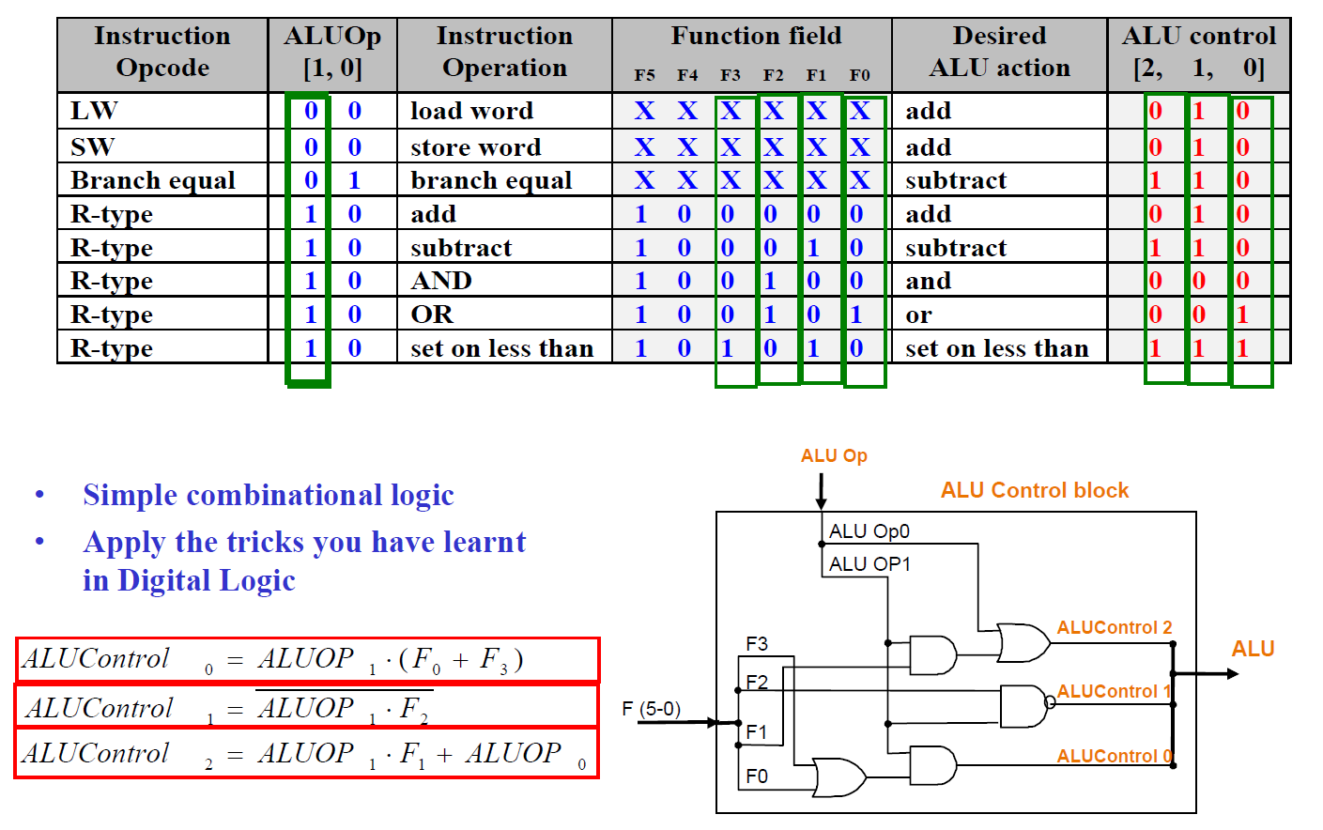
Control unit
ALU Control – Mapping of the input and output
Input: ALUOp (2-bit) + funct (6-bit, instruction [5:0])
Output: 3-bit ALU Operation

Slide 28
Project Phase 2
Specification
Materials
Submission
Test cases

Slide 29
Project Phase 2
In order to have a more in depth understanding of CPU architecture, you have to write assembly programs, a single-cycle simulator and a multi-cycle pipelined simulator of a simplified CPU.
In phase 2, you have to write a single cycle simulator in standard C, so that you gain experience in understanding the datapath design and how instructions execute in single cycle machine.

Slide 30
Project Phase 2

Slide 31
Project Phase 2
Architecture in phase 2:
Each machine word has 32 bits.
Memory size is exactly 64Kb (16 bits are sufficient to specify an address).
All store and load operations are word-aligned.
Every instruction takes one machine word.
The machine is big-endian, i.e. the most significant byte comes first.
The registers available are listed in table 1.
You are required to implement only a reduced subset of some usual CPU instructions, as shown in table 2.
The encoding of the instructions is given in table 3. For the representation, the row shows what is contained in a field, and the header row shows the number of bits of each field.
Register Name | Remarks | Remarks
$zero | Always has value 0 | 0x00
$ra | Return address | 0x01
$fp | Frame pointer | 0x02
$sp | Stack pointer | 0x03
$hi | High-word | 0x04
$lo | Low-word | 0x05
$s1, $s2,...,$s26 | General purpose registers | 0x06,0x07,...

Slide 32
Project Phase 2
Instruction Set
Instruction | Usage | Binary Representation
 |  | 6 | 5 | 5 | 5 | 5 | 6
Add | add rd,rs,rt | 0x0f | rs | rt | rd | 0 | 0x11
Add Immediate | addi rt,rs,imm | 1 | rs | rt | imm
Subtract | sub rd,rs,rt | 0x0f | rs | rt | rd | 0 | 0x12
Multiplication | mult rs,rt | 0x0f | rs | rt | 0 |  | 0x18
Division | div rs,rt | 0x0f | rs | rt | 0 |  | 0x1a
And | and rd,rs,rt | 0x0f | rs | rt | rd | 0 | 0x2a
Or | or rd,rs,rt | 0x0f | rs | rt | rd | 0 | 0x2b
Shift Left Logical Variable | sllv rd,rt,rs | 0x0f | rs | rt | rd | 0 | 1
Shift Right Logical Variable | srlv rd,rt,rs | 0x0f | rs | rt | rd | 0 | 2
Load word | lw rt,offset (rs) | 0x1a | rs | rt | offset
Store word | sw rt,offset (rs) | 0x1b | rs | rt | offset
Set Less Than | slt rd,rs,rt | 0x0f | rs | rt | rd | 0 | 0x25
Branch on Not Equal | bne rs,rt,label | 2 | rs | rt | offset
Jump | j target | 3 | target
Jump Register | jr rs | 0x0f | rs | 0 |  |  | 3
Jump And Link | jal target | 4 | target

Slide 33
Project Phase 2
Simulator
The input to the simulator is a binary file, where every 4 bytes represent a word in big-endian format.
You may assume that the input file size is always a multiple of 4.
Your simulator should treat each word in the input as an instruction and try to simulate it.
Your simulator should halt when the fetched instruction is 0x0.
Your simulator should also halt when the fetched instruction is invalid (which means instructions not shown in Table 3). In this case, you need to store your student ID in register $s26.
For simplicity, all rs and rt for mult and div should only contain non-negative numbers.

Slide 34
Project Phase 2
Task: Implement 22 functions
“run_program_counter()” is completed for you as an example
void run_program_counter(unsigned Next, unsigned *PC) {
*PC = Next;
}

Slide 35
Project Phase 2

Slide 36
Project Phase 2
Provided Materials
simulator_linux
reference simulator compiled in linux1 of our department
complie.sh
shell script to compile and run your simulator
asm_linux
assembler program compiled in linux1 of our department
*.asm, *.asc
sample code for your testing
bz162.zip
a binary editor for you to add invalid instructions
components.h
header file defines the data structure representing each component
simulator.c
main function of the simulator
phase2.h
header file defines the functions you have to complete
phase2.c
Program skeleton (your code here)

Slide 37
Project Phase 2
Testing your program
Compare with sample simulator:
“./simulator_linux machine_code.asc”
Generate *.asc from MIPS:
“./asm_linux assembly_code.asm machine_code.asc”
Generate invalid instructions:
Use BZ!
P.S. simulator_linux and asm_linux can be run in Linux only.

Slide 38
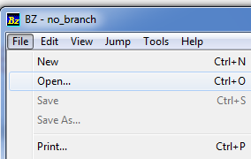
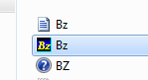
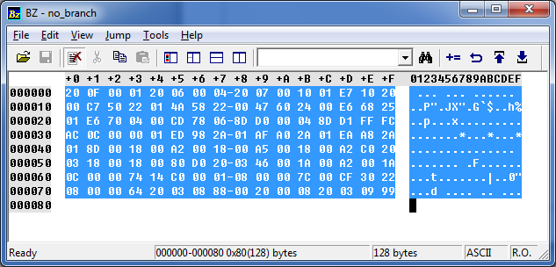
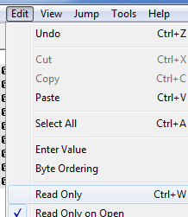
Project Phase 2
How to create invalid instructions?
Unzip bz162.zip
Open the Bz.exe
In Bz.exe, click “File->Open” to open *.asc file.
Then you will see the content of that file.
You can change the content to a invalid machine code in this editor

Slide 39
Project Phase 2
Submission:
Submit only “phase2.c”.
You MUST submit the C file to the submission system on our course homepage (within CUHK network), otherwise, we will NOT mark your assignment. The details of how to use the system will be announced later.
Please limit the file size to be less than 1MB.
Plagiarism will be seriously punished.
Late submission will NOT be accepted, and the submission time will be determined according to our submission system.

Slide 40
Project Phase 2
Test cases:
mult
div
add_sub
addi
addi_neg
and_or
sllv_srlv
lw
sw
slt
slt_neg
bne
j
jr
jal
zero_register
Invalid instruction

